Slide 1

MEDIA SURVIVAL ANALYSIS
BHARAT HERALD

Slide 2
BHARAT HERALD
OBJECTIVE: Leverage data-driven insights to diagnose Bharat Herald’s decline and design a phased digital-first roadmap to revive revenues, rebuild advertiser trust, and re-engage readers.
ANALYSIS PERIOD : Jan 2019 to December 2024
SOCIAL PARAMETERS : Literacy rate , Smartphone penetration, Internet penetration.
ANALYSIS PARAMETERS : Digital Readiness , Copies sold , Net Circulation, Ad revenue per net circulated copy , Bounce Rate(users who disengaged quickly) , Customer Acquisition Cost.
CITIES : Mumbai, Delhi , Kanpur , Lucknow , Varanasi , Ranchi , Patna , Ahmedabad, Jaipur , Bhopal

Slide 3
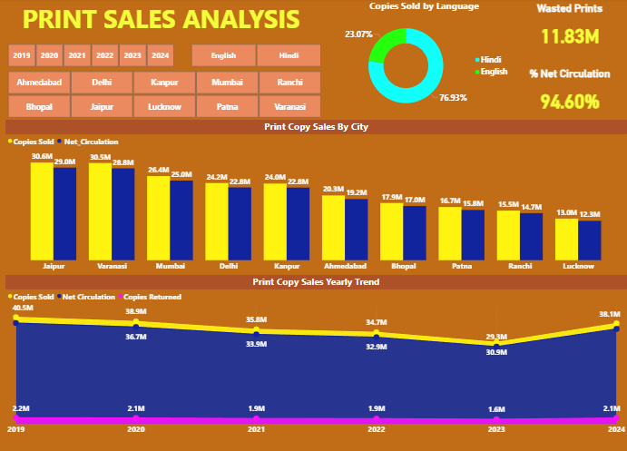

Slide 4
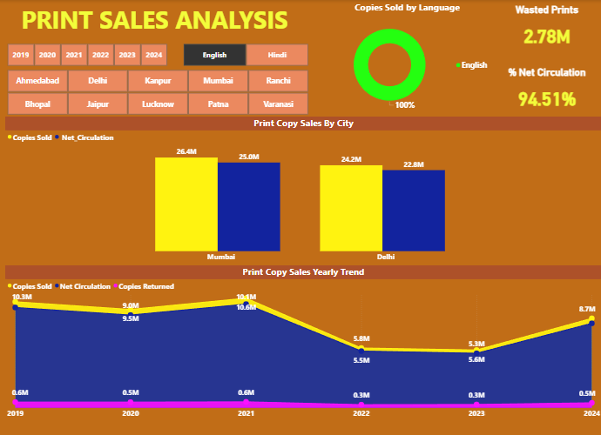

Slide 5
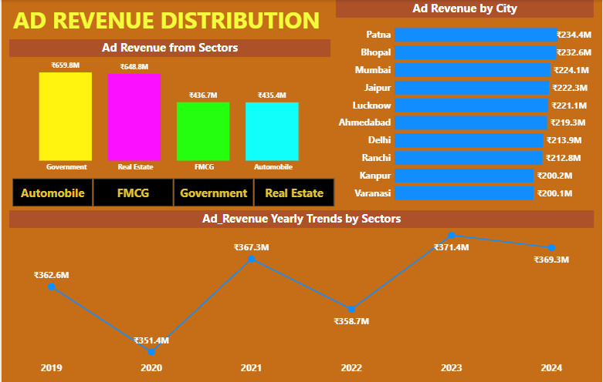

Slide 6
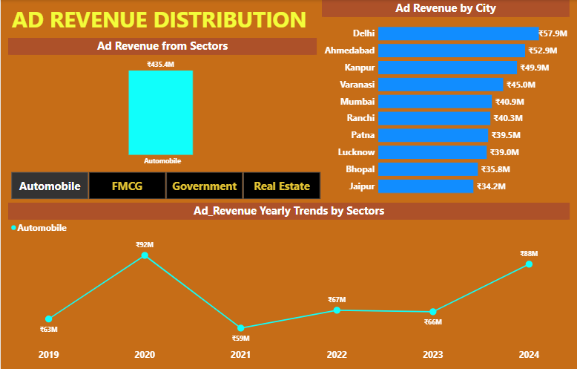

Slide 7
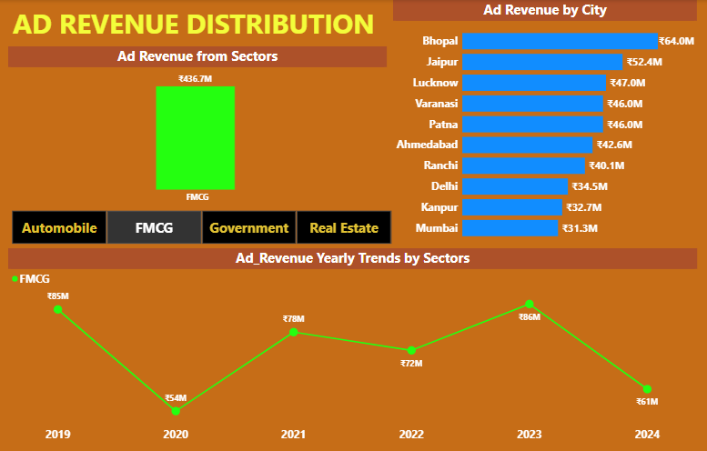

Slide 8
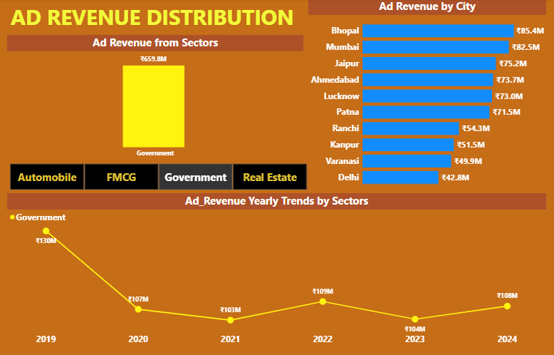

Slide 9
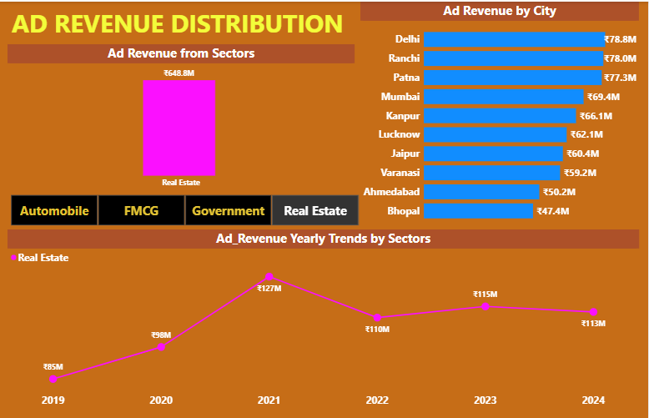

Slide 10
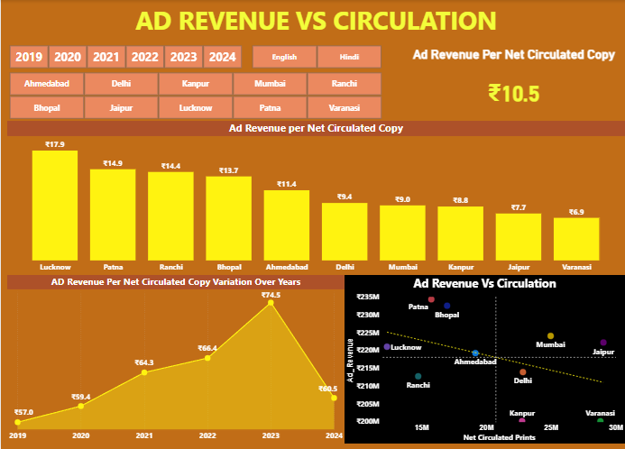

Slide 11
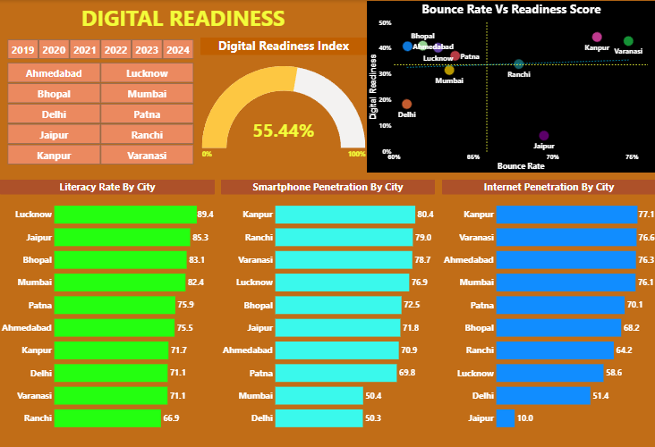

Slide 12
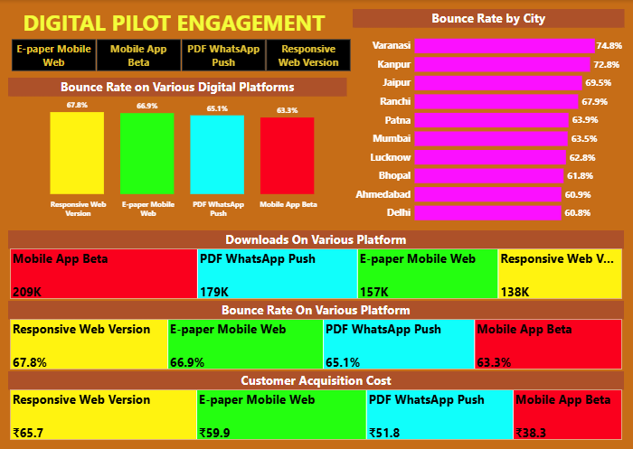

Slide 13

What Went Wrong
Print Decline: Circulation dropped ~50% (2019–24), weak presence in Ranchi, Lucknow.
Failed Digital Pilot: 2021 e-paper lacked usability → shelved.
Revenue Volatility: Ad revenues dipped sharply during COVID; gov. & FMCG ads shrinking.
Digital Weakness: High bounce rates (Varanasi, Kanpur), poor web adoption.
Advertiser Trust Erosion: Payment delays + bureau closures weakened credibility.

Slide 14
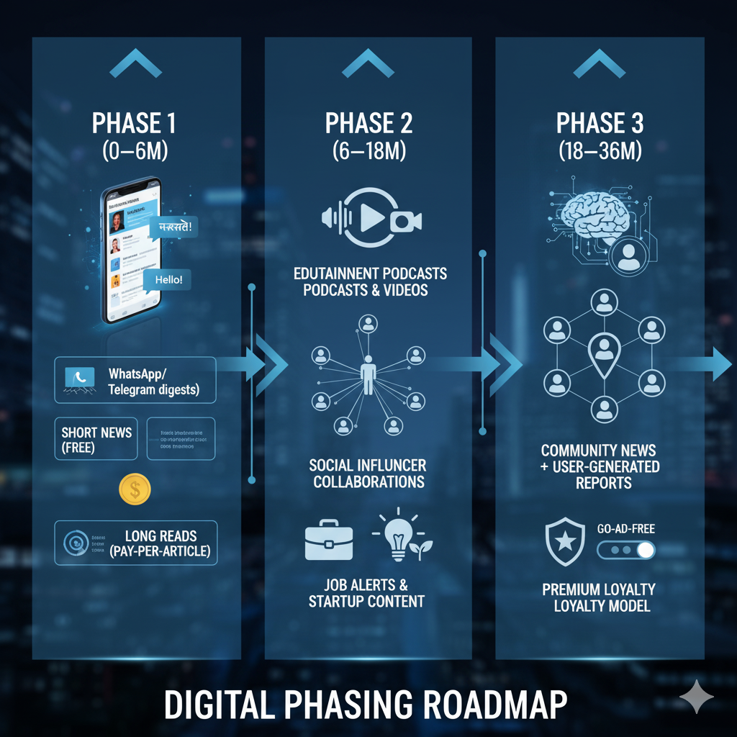

Slide 15
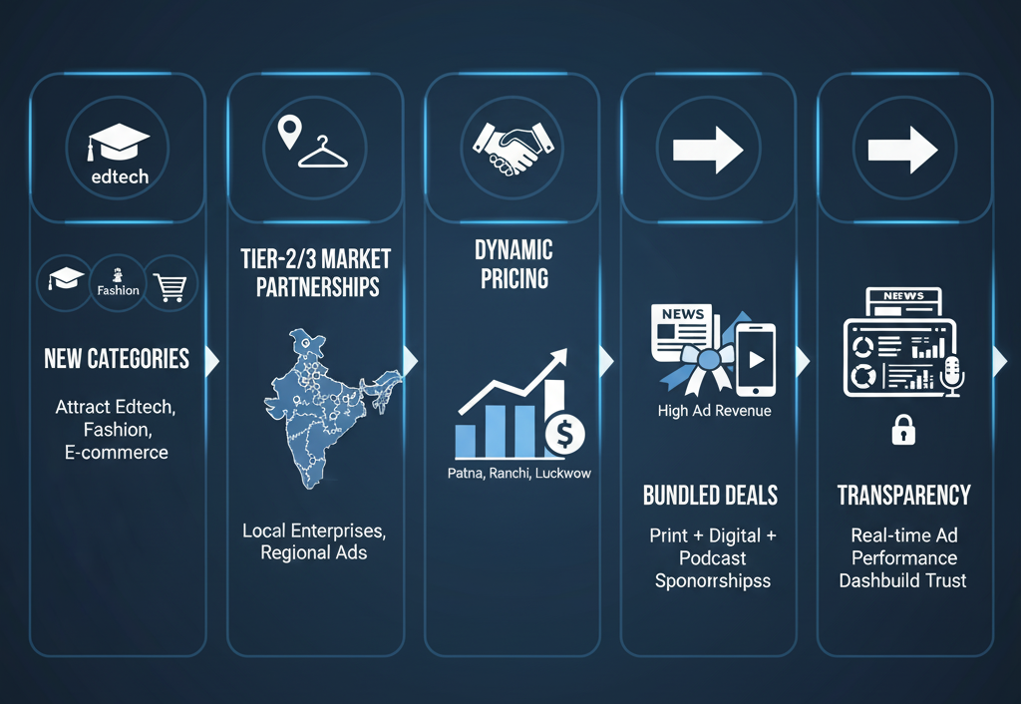
Scaling & Diversifying Ad Revenue

Slide 16
